Slide 1
Java's Generic Collections

Slide 2
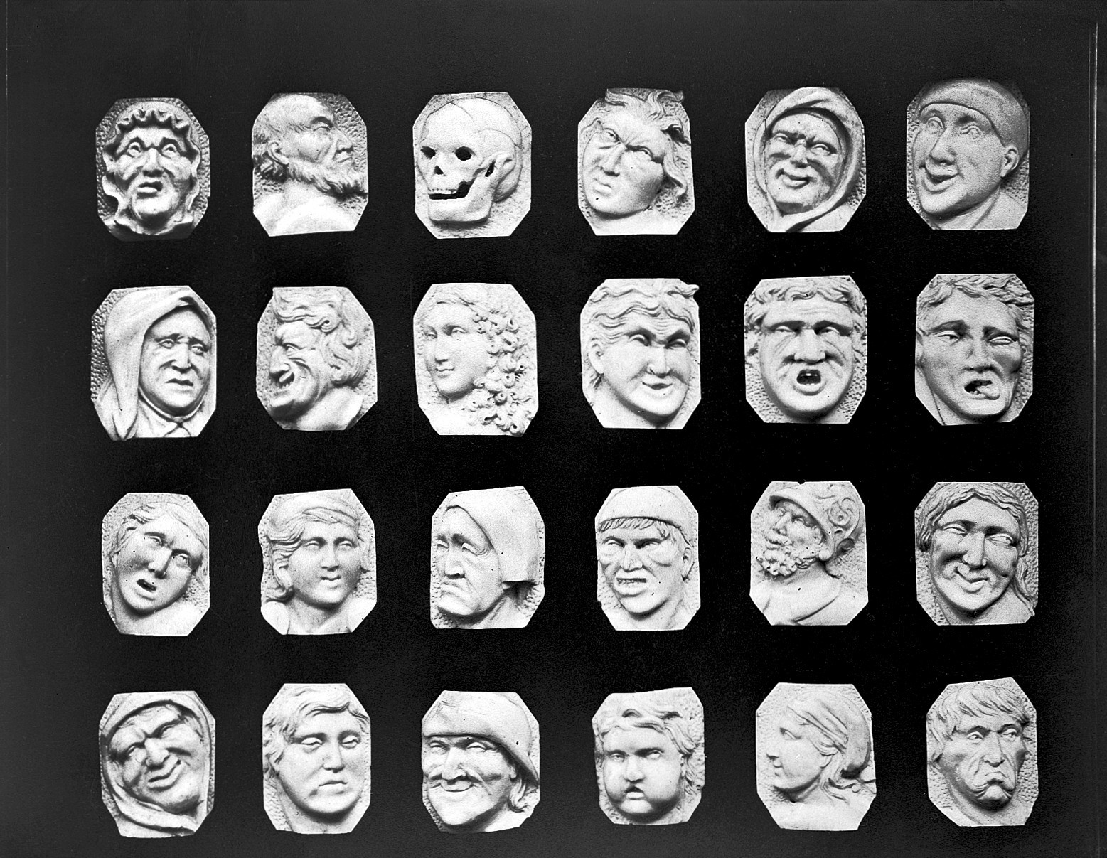

Slide 3
Collections
List
ArrayList
Set
HashSet
Map
HashMap

Slide 4
List: An Ordered Collection

Slide 5
Set: Collection with Unique Elements

Slide 6
Map: A Single Value for Each Unique Key

Slide 7
Summary

Slide 8
Interfaces
Implementation
Multiple Data Structures
Specific Data Structure
Functional Characteristics
Performance Characteristics
Prefer as variable type
Concrete and Instantiable
Often has a popular implementation

Slide 9

Summary
Introduced Collections
Studied Lists, Sets and Maps
Most common use of Generics

